Slide 1
SOEN 341
Domain Model
http://agiledata.org/essays/agileDataModeling.html
Scott Ambler

Slide 2
The Model
Karate School Management System
Overall system:
Names and Associations (Refer to user stories)

Slide 3
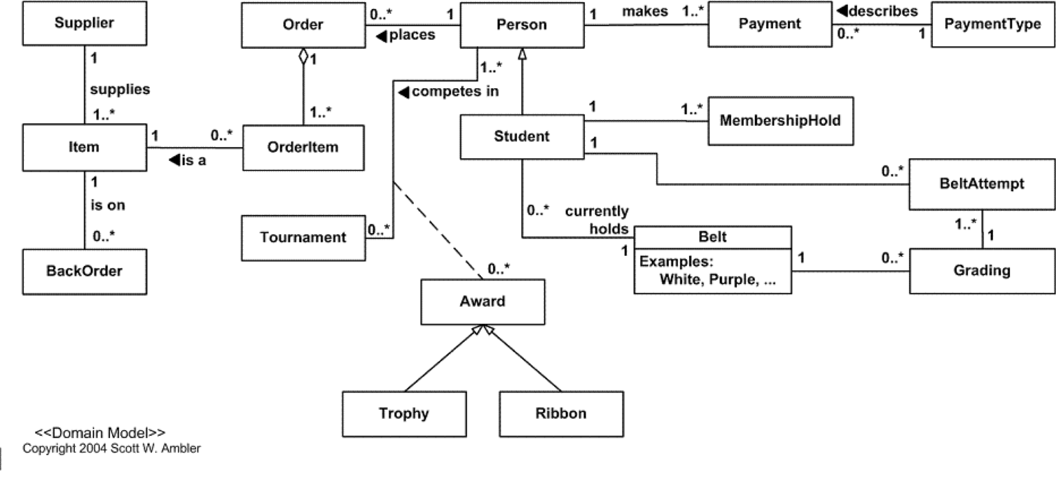
Maintain student contact information Define entities Refer to table 1 user stories

Slide 4
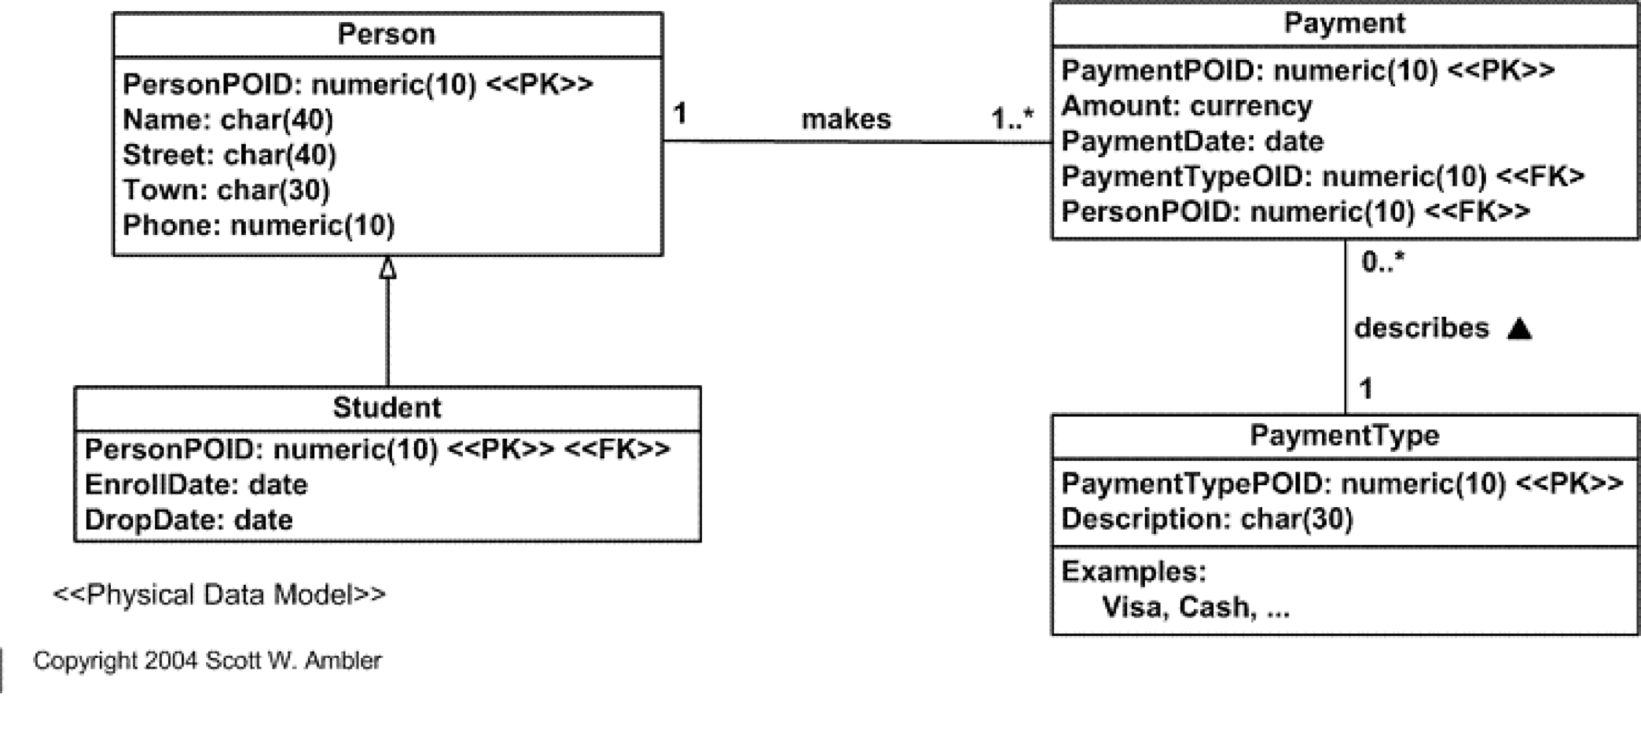
Iteration 1 Maintain student contact information, Enroll student, Drop student, and Record payment. 4 stories:

Slide 5
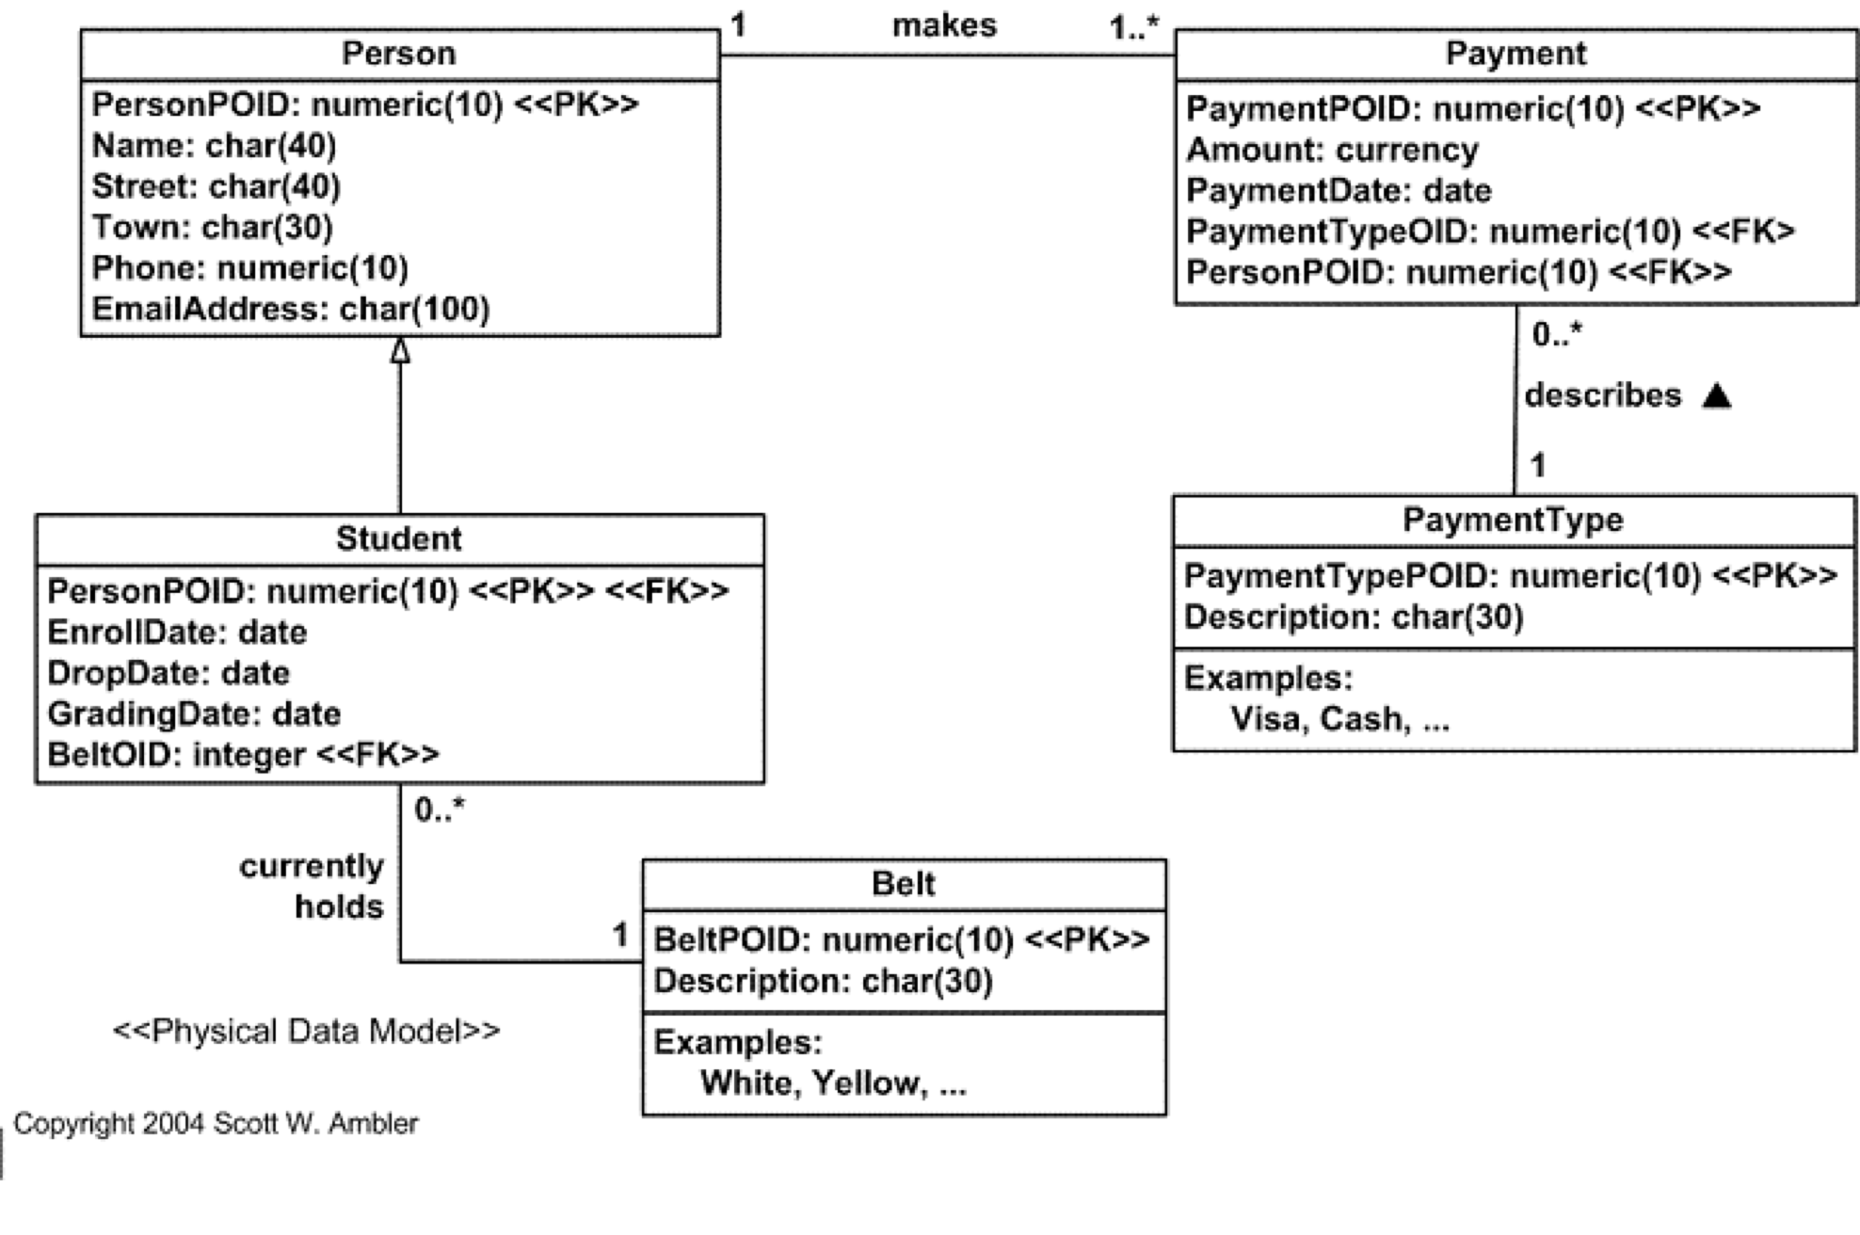
4 user stories to implement during this iteration: Promote student to higher belt, Invite student to grading, Email membership to student, and Print membership for student.

Slide 6
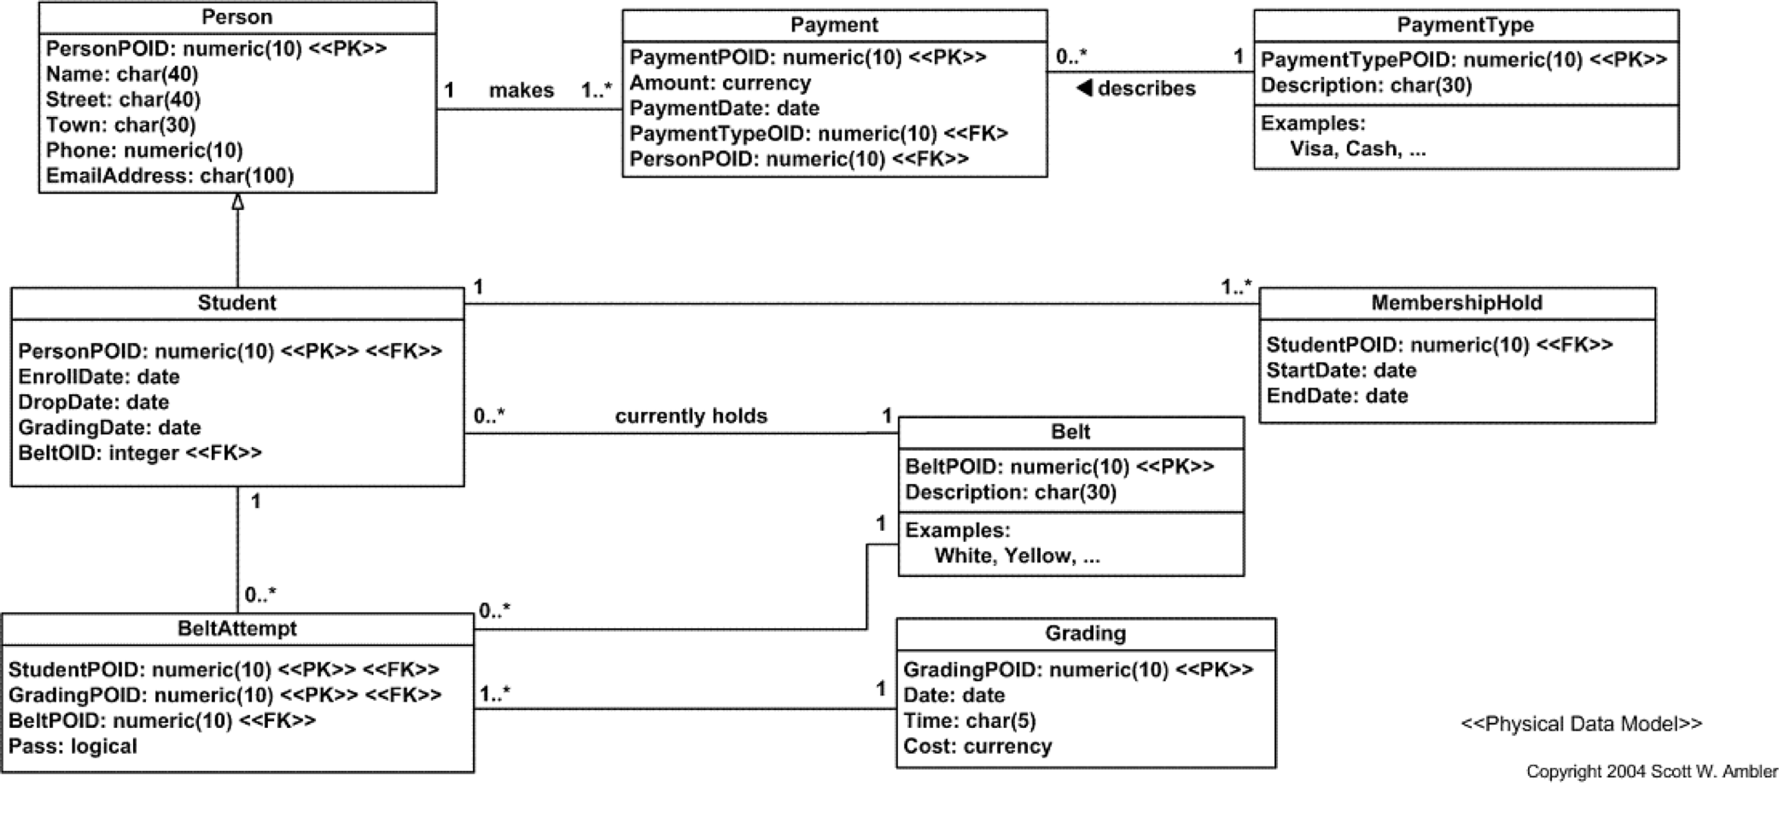
3 user stories to implement: Schedule gradings, Print certificate, and Put membership on hold.

Slide 7
Requirements change
Add tournaments
Add Tai Chi, Kick Boxing
New Requirements
Table 2

Slide 8
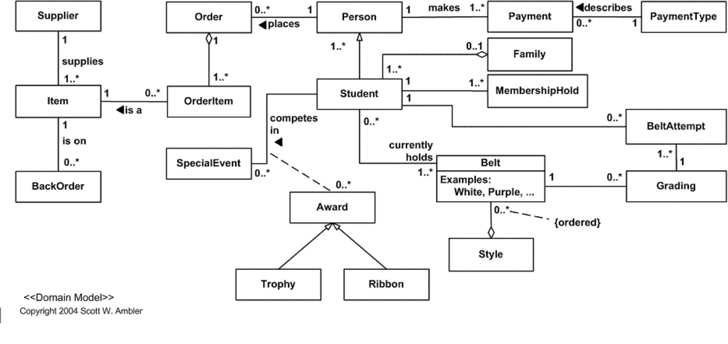
New Domain model

Slide 9
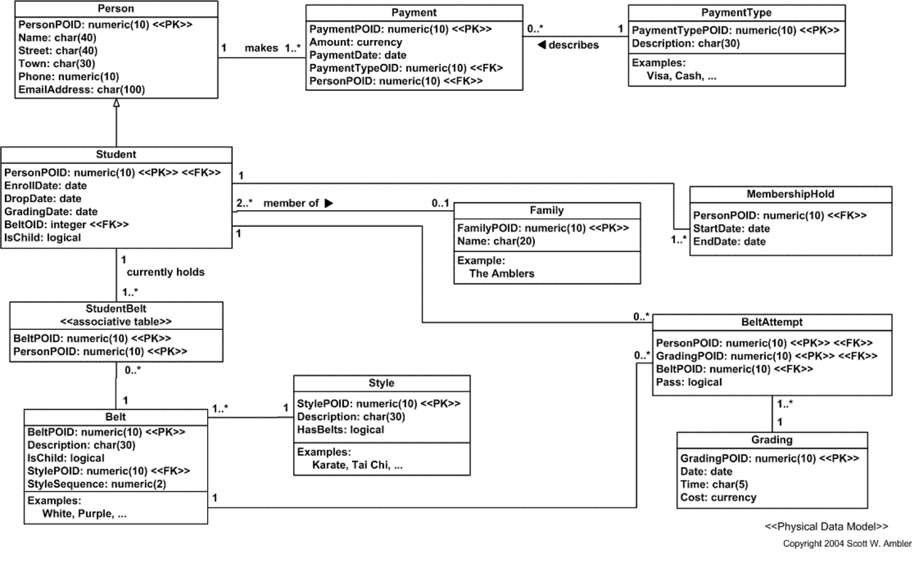
5 user stories to implement: Enroll student in Tai Chi, Support Tai Chi belt system, Enroll student in cardio kick boxing, Support Tai Chi belt system, and Support the belt order for each style.

Slide 10
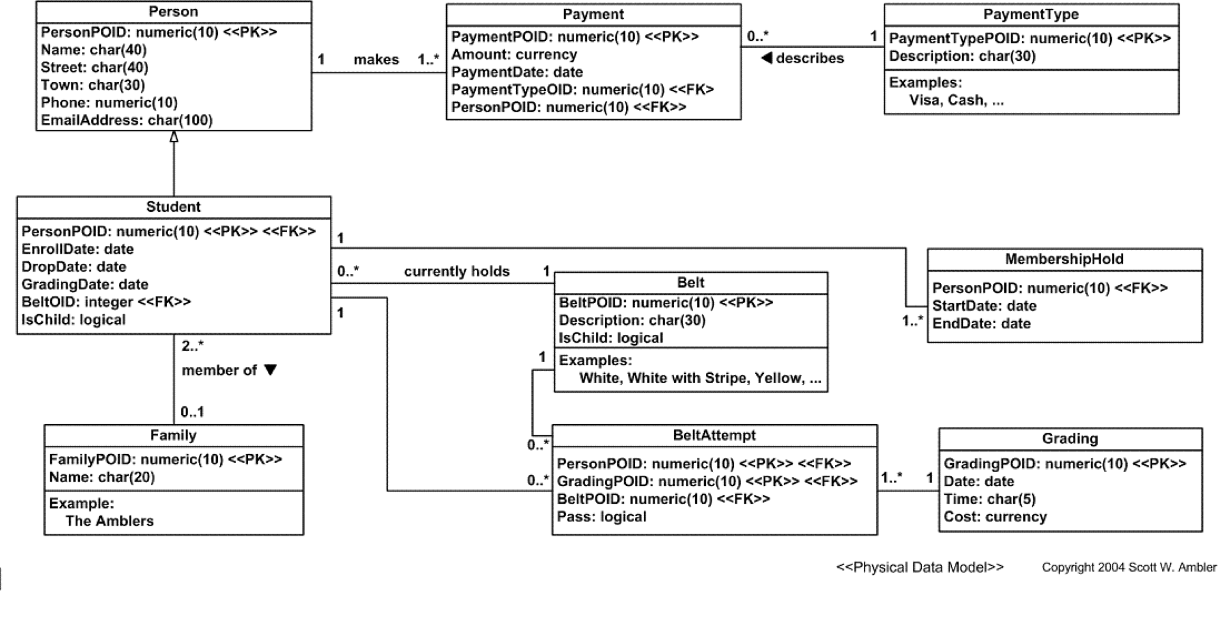
Enroll child student, Offer family membership plan, and Support child belt system.

Slide 11
2 user stories to implement: Maintain product information and Sell product.

Slide 12
